Slide 1
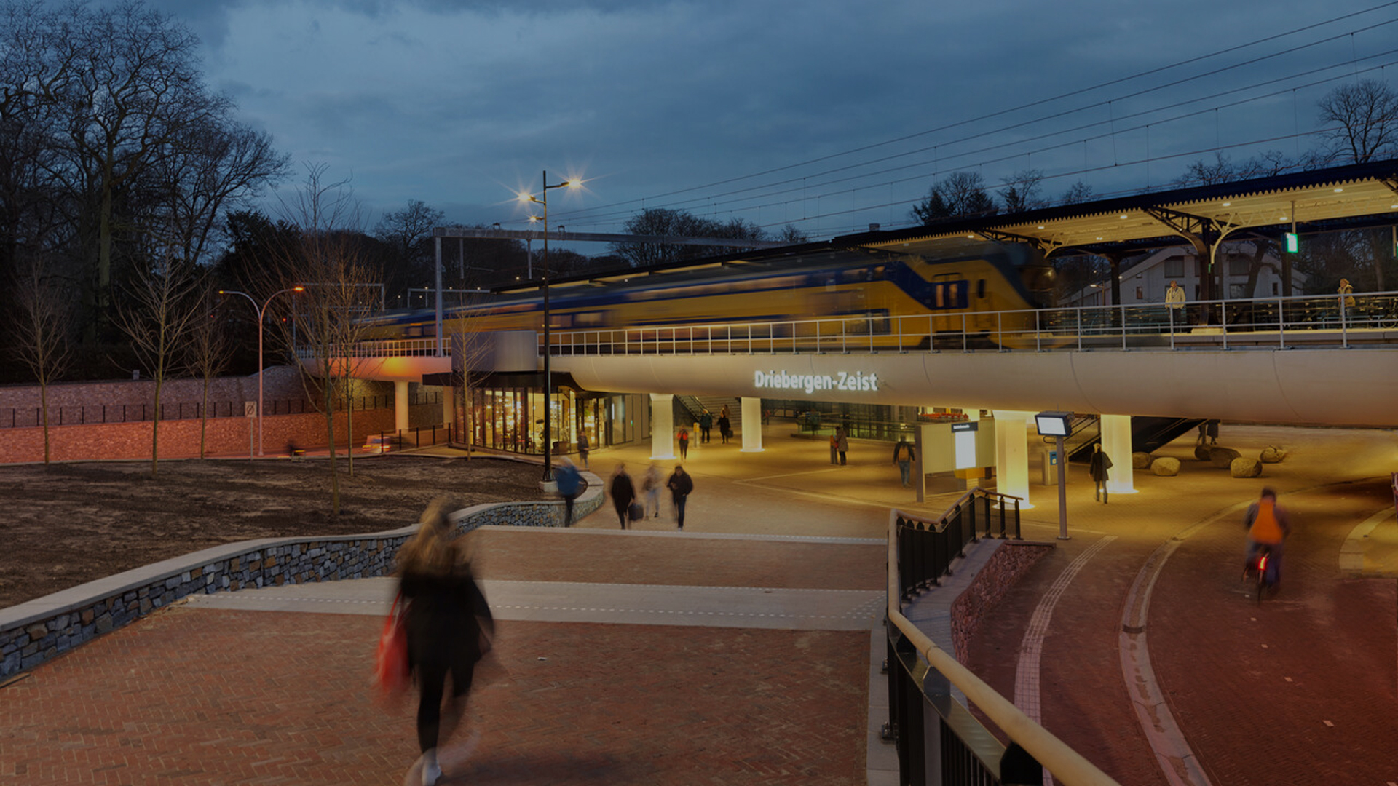
Materiaal passports en digital product passports in the built environment
Janneke Bosma jambosma@gmail.com Construction Management & Engineering

Slide 2
De underlying steps
‘lay out’
Validate
The data
Converter IFC/RDF
Ontology
SHACL
validation report
Revit model
IFC
Python 1
RDF
Python 2
the model of the building/object
Data verification (SHACL) of the RDF data
Report with missing/wrongly completed parts
Retrieve data
SPARQL
Linked data

Slide 3
De underlying steps
1
‘lay out’
Validate
The data
4
Converter IFC/RDF
Ontology
SHACL
validation report
3
Revit model
IFC
Python 1
RDF
Python 2
2
the model of the building/object
Data verification (SHACL) of the RDF data
Report with missing/wrongly completed parts
Retrieve data
SPARQL
5
Linked data

Slide 4
Excercise
The following slides show the process of arriving at a validation report. Currently a converter is used that does not yet convert the DPP parts to RDF (From IFC to RDF) along with it. These are therefore manually supplemented in the example RDF discussed later in the PowerPoint. If you convert an IFC file yourself it does not yet contain the correct information to comply with the validation process and the DPP parts will come out as an error message.
If you would like to see how the tool works: use the pre-selected TTL (RDF) file called TestfileX available in Github.
This can be loaded to go through the validation steps and practice the process. If you want to do this you can skip slides 5 through 12 except for setting up python.

Slide 5
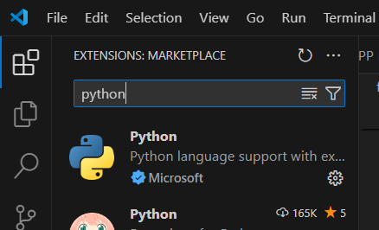

Downloads
1
Download Visual Studio Code (VSC)
https://youtu.be/9o4gDQvVkLU
2. Follow the steps from the link above and the website below if you are unfamiliar with Python:
https://code.visualstudio.com/docs/python/python-tutorial
3. Download IFCtoLBD and Namespaces from github, save in your created environment (e.g. in a specific folder) and open in VSC (File -> open file at top left)
https://github.com/JannekeBosma/DPP
4. Download required packages displayed in IFCtoLBD file (see next slide)
Packages:
from datetime import datetime
import ifcopenshell as ios
import Namespace
import os
import re

Slide 6
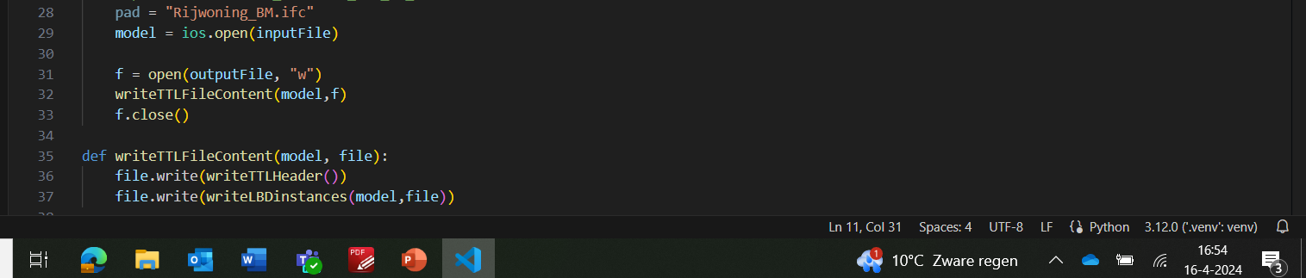
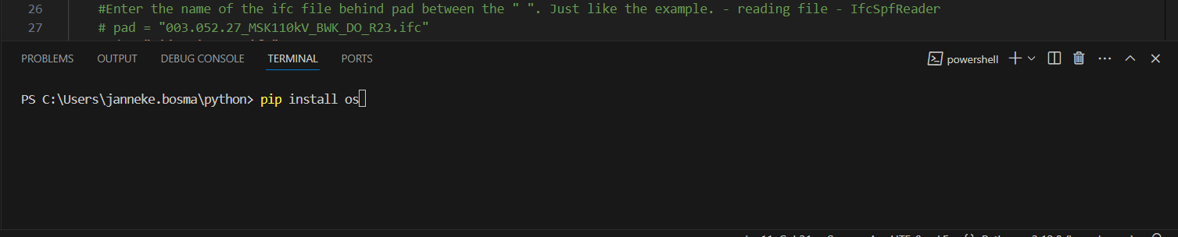
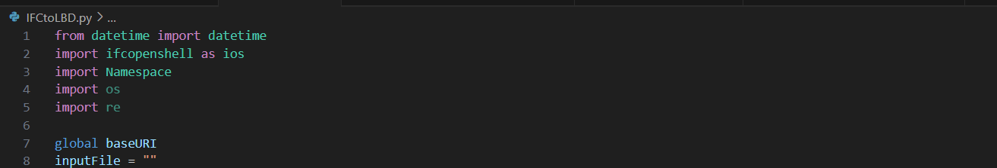
Downloads
1
Install the packages. To do this, pull up the terminal at the bottom of the screen.
2. Install the required packages in the terminal using pip install ...name package....
3. If properly installed it looks like this (namespaces represents the file namespaces downloaded from github).
If not installed it can be identified by a yellow or red underscore

Slide 7
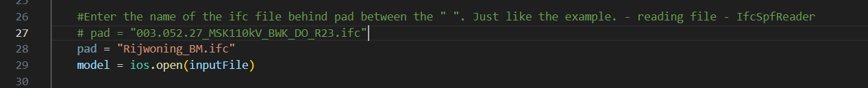
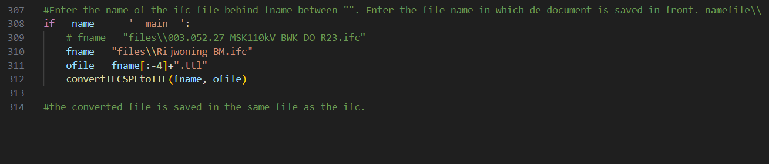
Convert IFC-LBD (RDF)
1
Save the ifc you want to convert to rdf in your python directory in the same location where your python file is saved
Enter the name of the ifc file you want to convert as shown in line 28. (By using a # you make sure that the text there is seen as a 'note' and then the file is not read. For example, in this example, line 27 is not read, but line 28 is).
Scroll down the script. Again, enter the name of the ifc file here. NOTE: If you have created a folder in your python environment where the ifc file is stored. Then put the name of the folder in front of it with ifc after it (in example, the folder is called files).

Slide 8
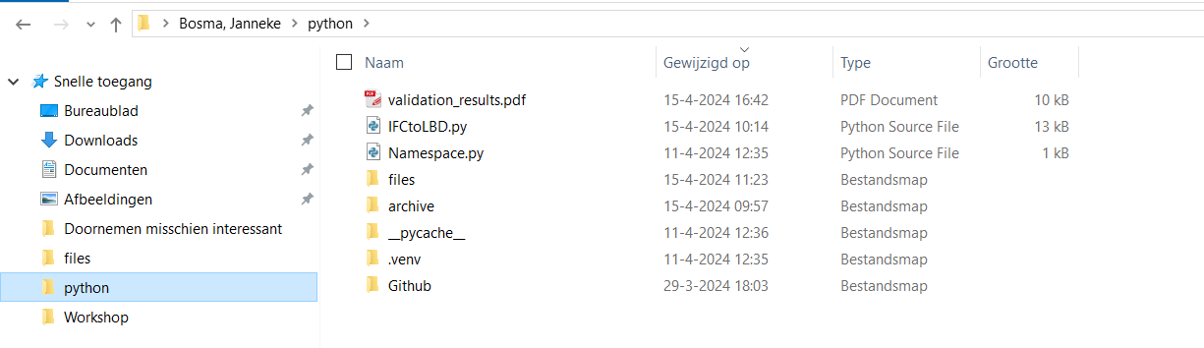
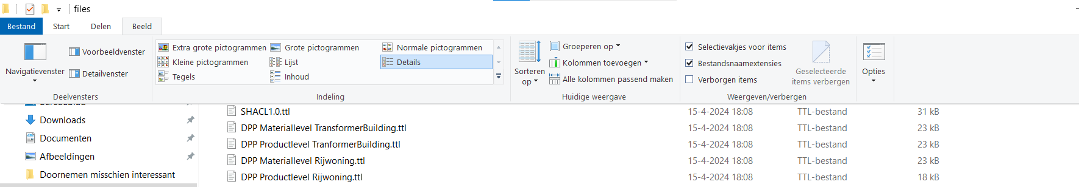
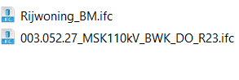
1
Convert IFC-LBD (RDF)
Example directory structure
Note: You can use file name extensions to check if the name is in there correctly (e.g. not ifc.ifc. Is after the file name)

Slide 9
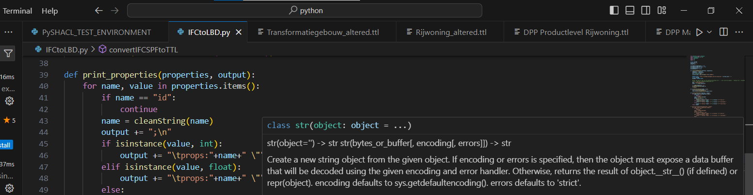
Converteer IFC-LBD (RDF)
1
Run the code when the names are filled in.
The converted ttl file (RDF) will appear in the same folder where your IFC was saved.

Slide 10
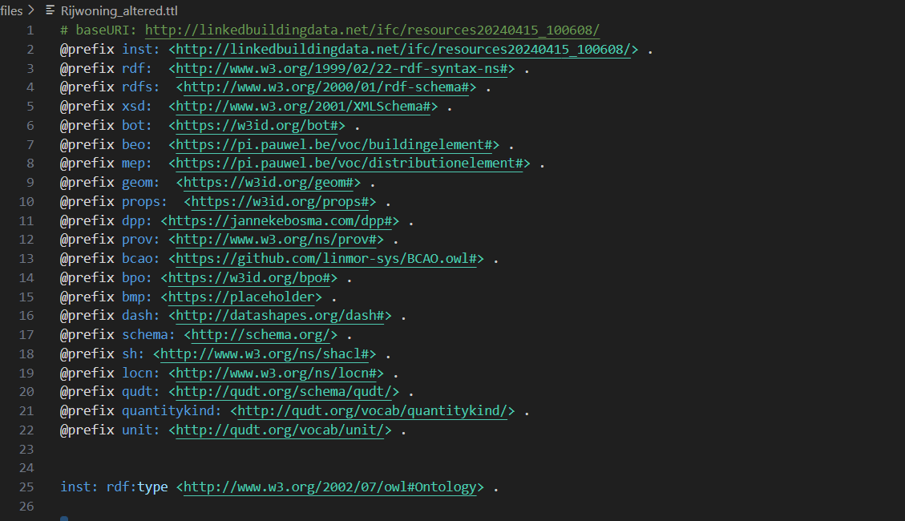
Check the RDF
2
Open the converted ttl file. Copy the appropriate prefixes at the top of the file. These are stored in Github
Check the file for errors. See some errors named on next slide

Slide 11
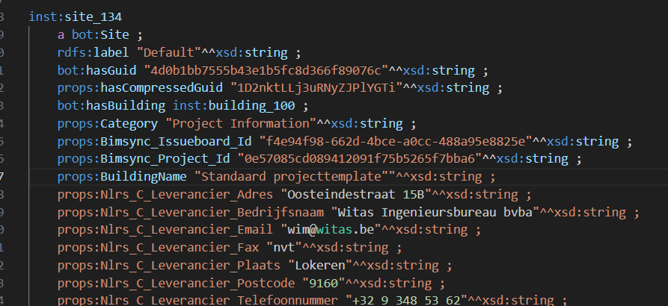
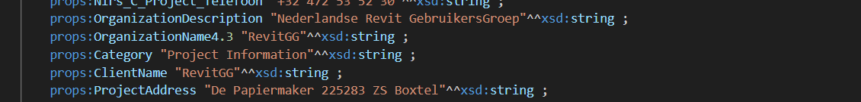
Controleer de RDF
2
One of the errors is the presence of a double ". This can be recognized by the color of the code. Also, errors in the naming can occur e.g. with . use in ex. 2. Here again a color difference can be seen in the 3.
In addition, errors may occur that will not be immediately visible in the text. In the next steps, if you want to start validating the RDF with the tool, these error messages will appear in the terminal. Don't be afraid if you see unfamiliar phrases or don't understand it right away. You can copy this text into chatGPT and it will indicate where it goes wrong or even point to the line where it goes wrong. For this it can be important to recognize which type of data (at the end of the sentence e.g. string and int) belongs to which completion (in orange). This is described in next slide. Again, if you can't figure it out, chatGPT may be able to help if you continue asking

Slide 12
Verschillende datatype en uitleg
2
Boolean: A data type that can only take two possible values: true (True) or false (False).VB: "True"^^xsd:boolean
Integer: An integer without decimals, positive or negative.VB: "50" ^^ xsd:int
String: A string of characters, such as letters, numbers and special characters.VB: "3d5rFF " ^^ xsd:string
Decimal: A decimal number with any number of decimal places.
VB: "0.5" ^^xsd:decimal

Slide 13
Controleer de RDF
2
At this time, the converter does not yet convert the DPP ontology. This means that it is not included in the previous step. Should this be updated in the future, previous steps should be completed with the new converter. Now the following steps can be done using a practice RDF file available in github.

Slide 14
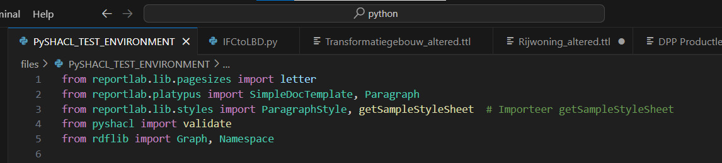
Valideer het RDF
3
Download the PySHACL_TEST_Environment file from Github along with the SHACL file. Save it in your python environment
Import the required packages (as described in slide 6) contained in the PySHACL file.

Slide 15
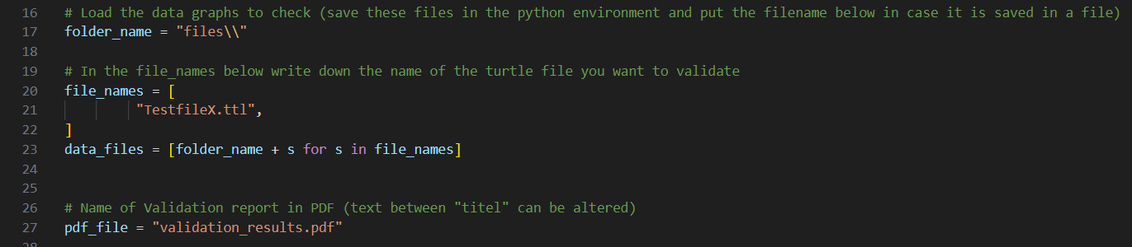
Valideer het RDF
3
Enter the name of the ttl file (RDF). Don't forget to name the folder name with † if it is stored in a folder (in line 17, see figure). In the example, the ttl file is stored in the folder named 'files'.
Run the code by clicking on the arrow at the top right as described in slide 9
If you want to practice with the validation tool start at this step by using practice fileX. You can download this from Github.

Slide 16
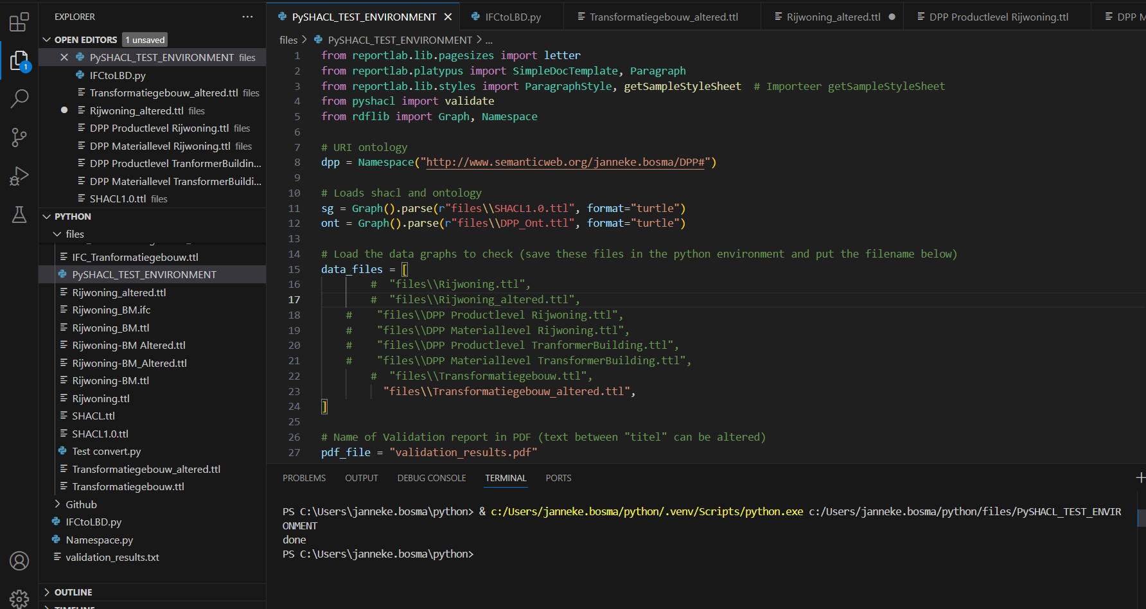
Valideer het RDF
3
The validation report can be found within the VSC environment as well as downloaded as a PDF in the same folder where the RDF is stored. The PDF also contains the missing classes (i.e. when a topic is missing in its entirety). The terminal in VSC only contains missing properties (when a topic is present but not all its information is complete).

Slide 17
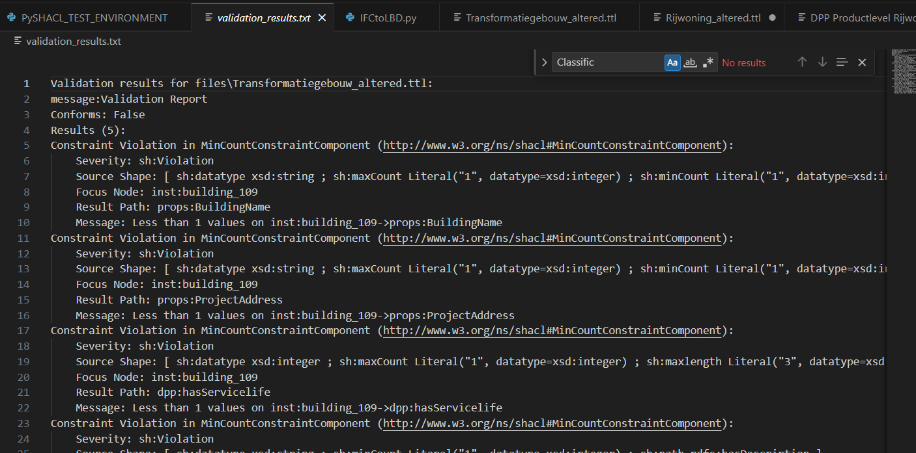
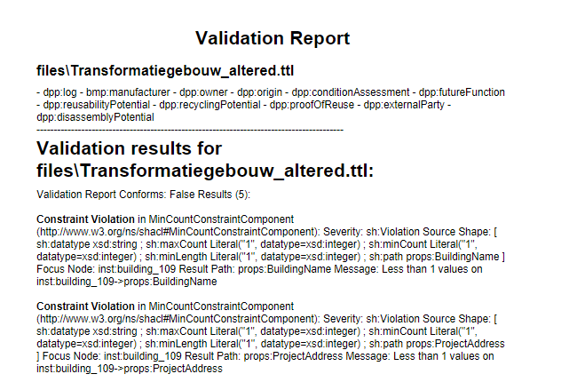
Valideer het RDF
4
Missing subjects
(classes)
The example in VSC and in PDF
See next slide for an example (in conjunction with this slide)
Missing properties
Missing properties

Slide 18
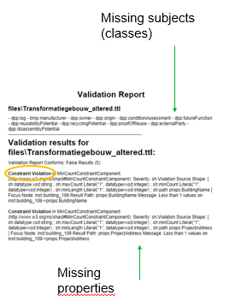
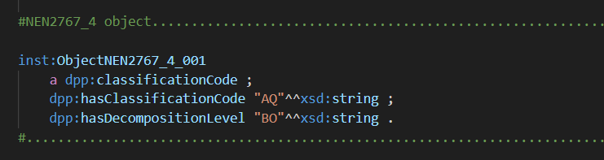
Voorbeeld classes en properties
4
When an error message comes at the top of the file, it means that the subject does not appear at all (missing class).
In this example, the classification code. If both the classification code (property) and the decomposition level (property) are missing, it will appear at the top of the PDF. If only the decomposition level is missing, it will appear at constraint violations

Slide 19
Het uitlezen van het validatierapport
4
Missing in totality
Eg. no information available about the origin of the elements in file transformation-building_altered
The error
Within file transformationbuilding_altered, information about ProjectAddress is missing at instance (subject/object) building_109

Slide 20
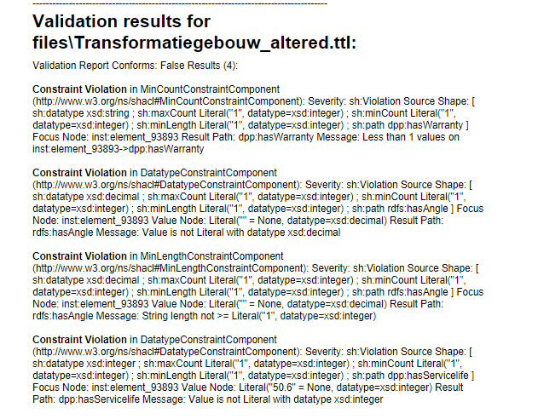
Voorbeelden foutmeldingen
4
These four error messages belong to incorrectly entered data in the RDF document. The following slide shows how these are filled in incorrectly and how they should be filled in

Slide 21
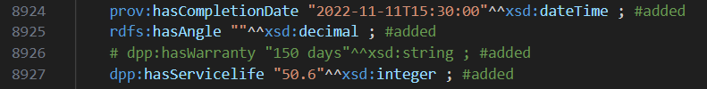

Voorbeelden foutmeldingen
4
In the example below, the data for angle is missing + warranty is 'invisible' (recorded as a note using #) so not present + servicelife is an integer but filled with a decimal.
The wrong data
The correct data
These errors can then be adjusted in the source (for example, the BIM model if the information was not added in it).

Slide 22
Voorbeelden foutmeldingen
4
Above all, try out the tool yourself with the testfileX. Make some mistakes in this, such as changing data type, making information invisible (putting # in front of it), etc.
The parts checked by the validation tool are identified by the # behind the rules. When you make adjustments within these parts, you will see this reflected in the validation report (building, and element level).
To extend the test file, the product and materials file can be linked. Just add the names of the files in the python code. This way you can also try out with this. The files are called: DPP productlevel Rowhouse and DPP materiallevel Rowhouse.

Slide 23
Let op!
5
The following slides will explain query creation. This is separate from the validation process.
This principle can be used when you receive datafiles and want to see certain information.
For example: you want to know how long the lifespan is of your walls. Then this information can be "queried" (provided this information is available/added in the data file).

Slide 24

Download GraphDB
5
Download GraphDB
There are tutorials available in GraphDB (including star wars tutorial).
Follow this tutorial. This one explains well the steps to be taken
After following the tutorial, you can load the TestfileX and the material and product file (as used above).

Slide 25
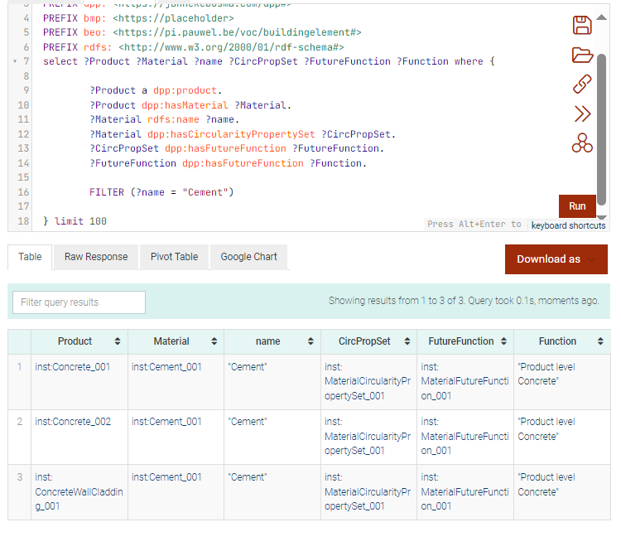
Het maken van queries
5
The prefixes
The names that appear at the top of
The table
Add the required prefixes in advance at the top of the screen where you will make the queries (this of all the ontologies you need. You can copy these from your testfileX, among other things).
In the thesis available in the github environment, there are several queries named that you can recreate. These can be found in the document's appendix.
Should you want to make other queries, feel free to ask chatgpt for help. He can help
To the right, see an example of a query run
Should anything go wrong. Ask chatgpt for help. He can suggest many solutions
The query
A filter to generate the
Materials with cement
The resulting table

